Slide 1

System Integrity
How to implement System Integrity, auditing, monitoring and how to protect it

Slide 2
System integrity Policies (Windows)
Enable Secure Boot (Firmware validates digital signatures ensuring only trusted computers sign in)
Configure User Access Control ( Creating groups for each role in AD, limit privileges)
Group Policies for hardening (Password complexity in GPO)

Slide 3
Auditing Security (Windows)
Enable Windows Auditing Policies ( Logon Events, Account Management, Object Access)
Audit User and Administrative Actions ( Track privileged accounts, audit user activity, PS logging)
Enable Windows Event Logs (Security Log, System log and Application Log)
File and Folder Auditing (File System access control and Object access auditing)

Slide 4
Monitoring System integrity (Windows)
Monitor Event logs for critical changes (Track specific ID events, and set up alerts)
Windows Defender and Monitor WDTP (Windows Defender Tamper Protection)
GPO Monitoring (GPO versioning such as Microsoft Advanced Group Policy Management)
Network and Firewall Integrity Monitoring (Monitor windows defender firewall)

Slide 5
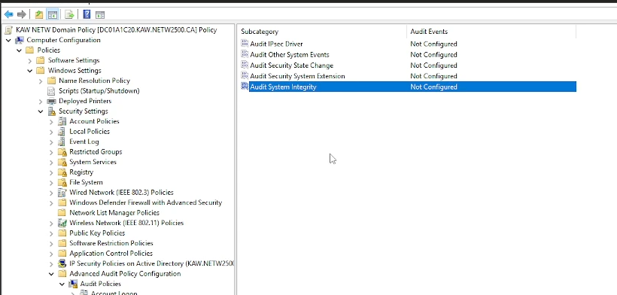
Comprehension break
What are 2 essential tools for monitoring system integrity in a Windows environment?

Slide 6
System Integrity (Linux)
Limit the use of Sudo
Harden the server (SELinux, disable SSH root login, change port #'s)
Enable Two-Factor Authentication

Slide 7
Auditing Security (Linux)
Audit the physical settings, protect GRUB with password
Audit the server for installed packages, remove what is not needed for security
Audit which ports are listening to ensure settings are correct
Audit the status of SELinux to confirm security is setup correctly

Slide 8
Monitoring Security (Linux)
Use a service like AIDE (Advance Intrusion Detection Environment)
Ensure SELinux is running as this will be enforcing rules set by the administrator
Monitor System Logs as these will inform you of the status and health of the OS
Use an IDS (Instrusion Detection System) to alert you of any unwanted network access which may harm the system

Slide 9
Comprehension break
Where are the system logs stored in Linux? (which directory)

Slide 10
Credit/Citations/Resources
https://learn.microsoft.com/en-us/previous-versions/windows/it-pro/windows-10/security/threat-protection/auditing/audit-system-integrity
http://aide.github.io/
https://www.isaca.org/resources/isaca-journal/issues/2015/volume-4/auditing-linuxunix-server-operatingsystem
https://stackify.com/linux-logs

